Slide 1
Capstone Project – 2 Supervised ML - Regression NYC Taxi Trip Time Prediction By- Vikrant Hada Vijay Jangid

Slide 2

Presentation Outline:
Problem Statement
Introduction
Exploring the dataset
Methodology
EDA and Data Processing
Decomposition of Data:PCA
ML Model – Regression
Conclusion

Slide 3

Problem Statement:
Our task is to build a model that
predicts the total ride duration
of taxi trips in New York City.
Our primary dataset
is one released by the NYC
Taxi and Limousine \Commission,
which includes pickup time,
geo-coordinates, Number of
passengers, and several
other variables.

Slide 4

Introduction:
The data is the travel information for the New York taxi. The prediction is using
the regression method to predict the trip duration depending on the given
variables. The variables contains the locations of pickup and drop-off presenting
with latitude and longitude, pickup date/time, number of passenger etc. The
design of the learning algorithm includes the preprocess of feature explanation
and data selection, modeling and validation. To improve the prediction, we have
done several test for modeling and feature extraction.

Slide 5

Exploring
the
Dataset

Slide 6
Data Summary:
Data Set Name -- NYC Taxi Data.csv - the training set
Statistics –
Rows - 1458644
Features - 11 (Including Target)
Target – Trip Duration Important
Column -- ‘id’, 'vendor_id', 'pickup_datetime', 'dropoff_datetime',
'passenger_count', 'pickup_longitude', 'pickup_latitude', 'dropoff_longitude',
'dropoff_latitude', 'store_and_fwd_flag', 'trip_duration’.

Slide 7
Data Menu:
Independent Variables –
id — a unique identifier for each trip
vendor_id — a code indicating the provider associated with the trip record
pickup_datetime — date and time when the meter was engaged
dropoff_datetime — date and time when the meter was disengaged
passenger_count — the number of passengers in the vehicle (driver entered value)
pickup_longitude — the longitude where the meter was engaged
pickup_latitude — the latitude where the meter was engaged
dropoff_longitude — the longitude where the meter was disengaged
dropoff_latitude — the latitude where the meter was disengaged
store_and_fwd_flag — This flag indicates whether the trip record was held in vehicle memory before sending to the vendor because the vehicle did not have a connection to the server — Y=store and forward; N=not a store and forward trip.
Target Variable –
trip_duration — duration of the trip in seconds

Slide 8
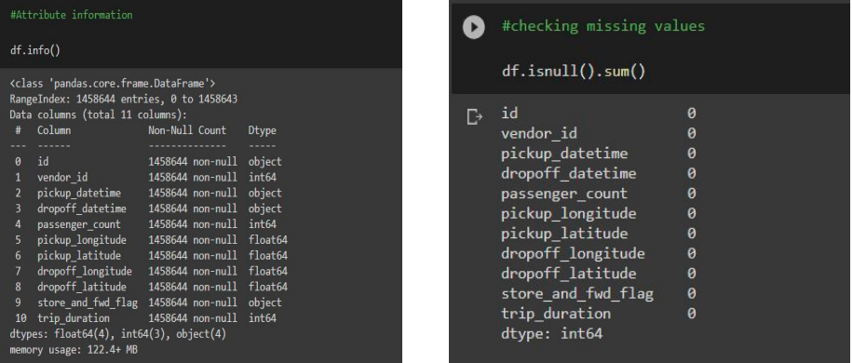
Attribute Information : Dtype and Null Values

Slide 9
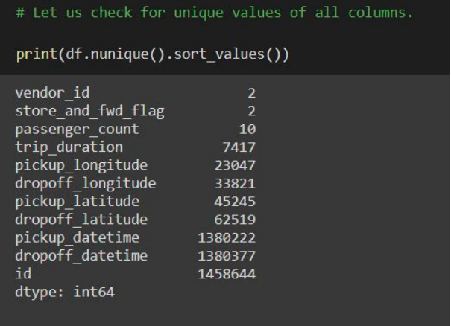
Attribute Information : Unique Values

Slide 10

METHODOLOGY

Slide 11
Approach
Data Preparation and Exploratory Data Analysis
Building Predictive Model using Multiple Techniques/Algorithms
Optimal Model Identified through testing and evaluation

Slide 12
Machine Learning Algorithm:
Decomposition: PCA
Linear Regression
Decision Tree
Random Forest
Tools Used:
Jupyter Notebook (Python)
Google Colab Research

Slide 13

EDA AND DATA PROCESSING

Slide 14
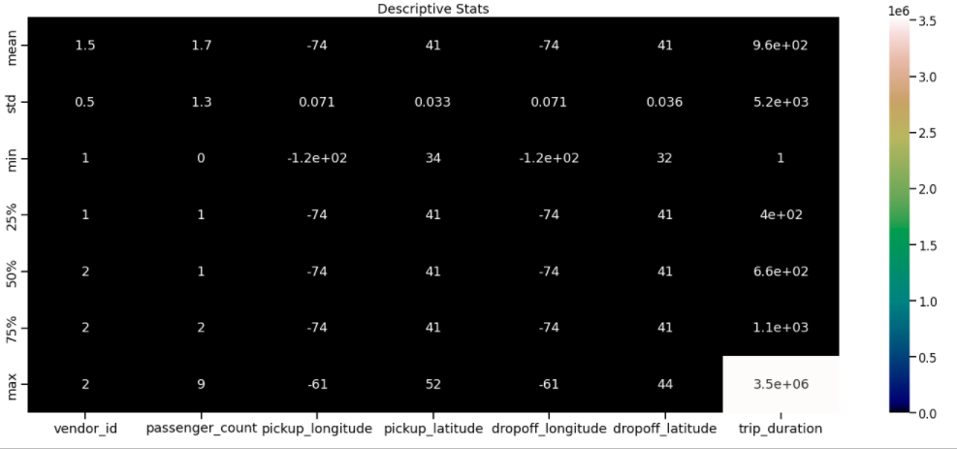
Descriptive Stats in Visual Form
We can observe that
There were trips having
0 passengers which we
can consider as false trip.
Also, there are trips
having trip duration upto
3526282 seconds
(Approx. 980 hours)
which is kind of
Impossible in a day.

Slide 15
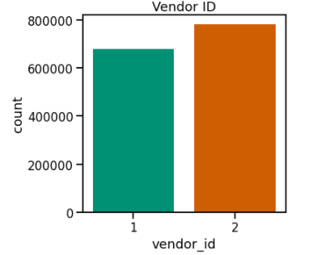
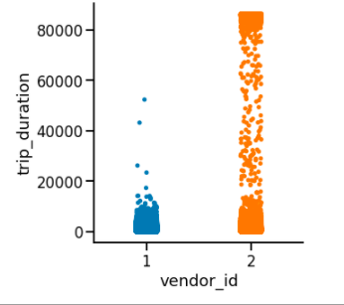
Analysis on : Vendor Id
Vendor id 2 takes longer trips as compared to vendor 1
From Above Visualization, we can say that there are 2 vendors (Service Providers).
2nd Service provider is the most opted one by New Yorkers.

Slide 16
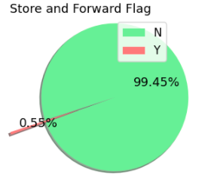
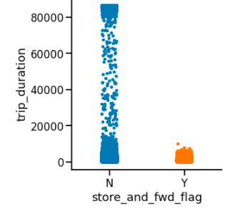
Analysis on : Store and Forward Flag
Trip duration is generally longer for trips whose flag was not stored.
We see there are less than 1% of trips that were stored before forwarding
The number of N flag is much larger. We can later see whether they have any relation with the duration of the trip.

Slide 17
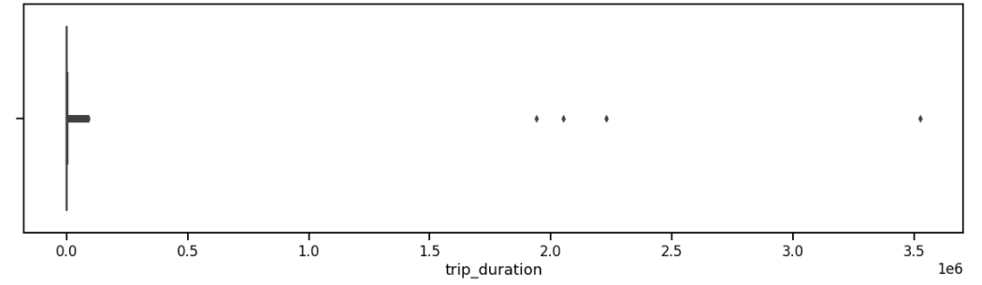
Analysis on : Target Variable – Trip Duration
Probably in this visualization we can clearly see some outliers , their trips are lasting between 1900000 seconds (528 Hours) to somewhere around 3500000 (972 hours) seconds which is impossible in case of taxi trips , How can a taxi trip be that long ?It’s Quite suspicious. We’ll have to get rid of those Outliers.

Slide 18
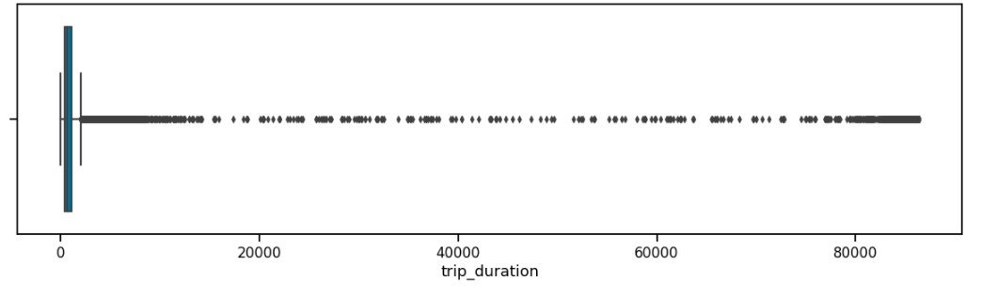
Analysis on : Target Variable – Trip Duration (Contd.)
We can see that there is some entries which is significantly different from others. As there is this 4 rows only, we drop these rows.

Slide 19
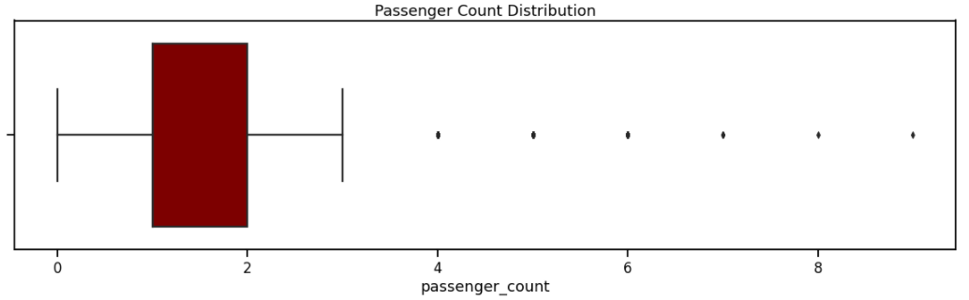
Analysis on : Passenger Count
There are some trips with even 0 passenger count. And 3 trips with 7 passengers. And there is only 1 trip each for 8 and 9 passengers.
Above visualization tells us that there were most number of trips are done by 1-2 passenger(s).
5 - 9 passengers trip states us that cab must be a Large vehicle.

Slide 20
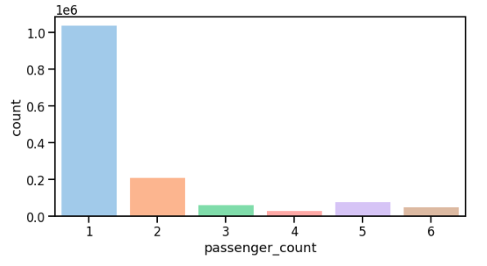
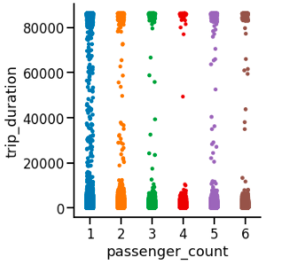
Analysis on : Passenger Count (Contd.)
Now, that seems like a fair distribution. We see the highest amount of trips are with 1 passenger.
There is no visible relation between trip duration and passenger count

Slide 21
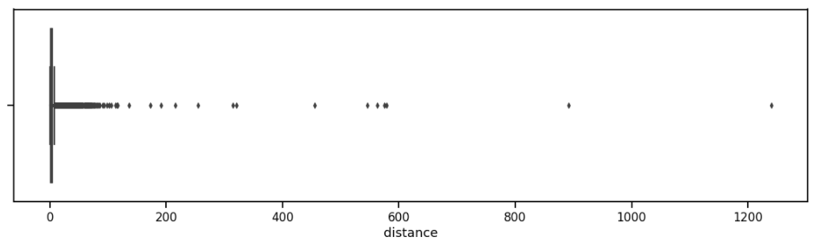
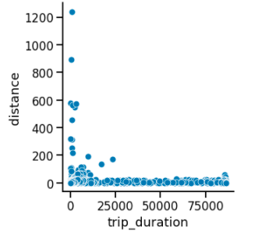
Analysis on : Distance
We can see there are trips which trip duration is as short as 0 seconds and yet covering a large distance. And, trips with 0 km distance and long trip durations.
The reasons for 0 km distance can be:
i. The drop off location couldn’t be tracked.
ii. The driver deliberately took this ride to complete a target ride number.
iii. The passengers canceled the trip.

Slide 22
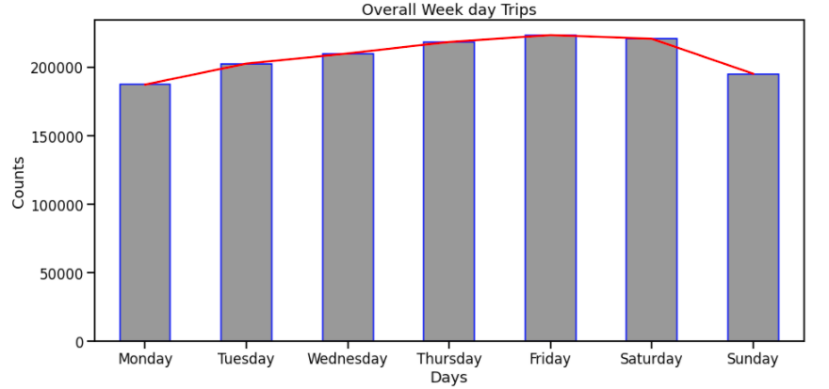
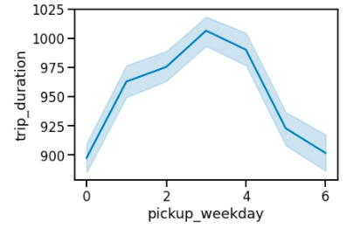
Analysis on : Trip Duration on a weekday
Trip duration is the longest on Thursdays closely followed by Fridays.
Observations tells us that Fridays and Saturdays are those days in a week when New Yorkers prefer to roam in the city.

Slide 23
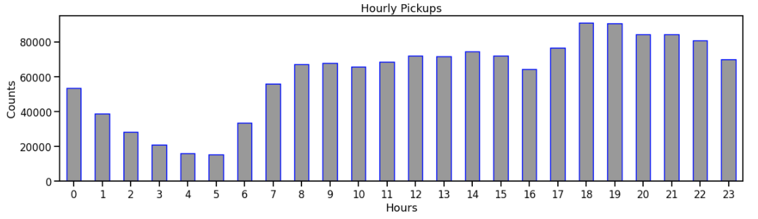
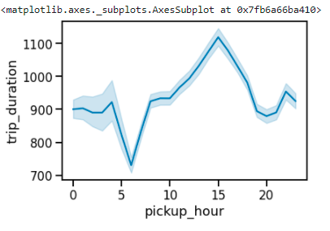
Analysis on : Trip Duration per hour
In which hour we get to see maximum pickups ? - Rush hours (5 pm to 10 pm), probably office leaving time.
Thus we observe that most pickups and drops occur in the evening. While the least drops and pickups occur during midday.
We see the trip duration is the maximum around 3 pm which may be because of traffic on the roads. Trip duration is the lowest around 6 am as streets may not be busy.

Slide 24
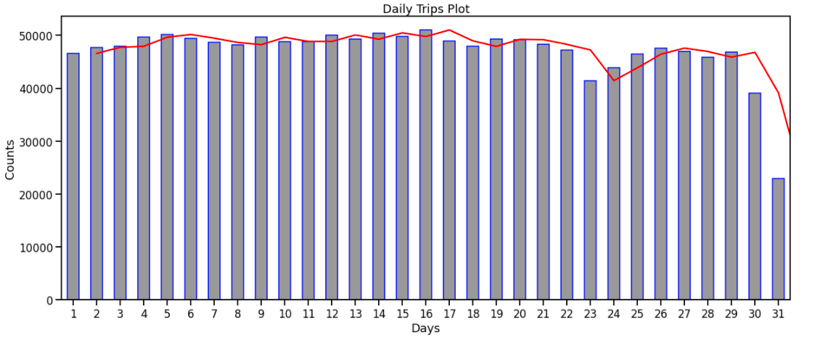
Analysis on : Trip Duration in a month
Seem like New Yorker’s do not prefer to get a Taxi on Month end’s , there is a significant drop in the Taxi trip count as month end’s approach.

Slide 25
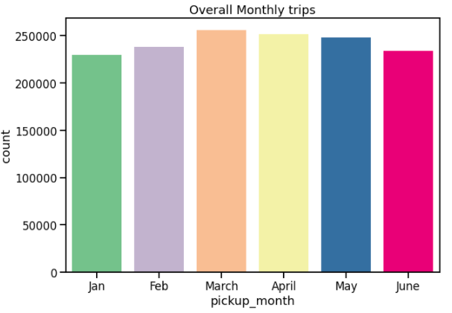
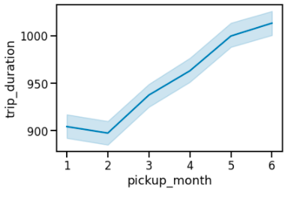
Analysis on : Trip Duration in 6 months
We've data of 6 months.
Number of trips in a particular month - March and April marking the highest.
January being lowest probably due to extreme SnowFall NYC.
From February, we can see trip duration rising every month.

Slide 26
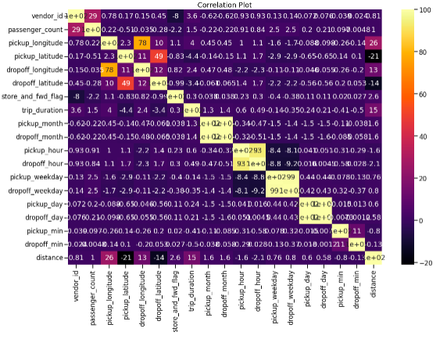
Analysis on : Correlation Heat map

Slide 27

Decomposition of Data: PCA

Slide 28
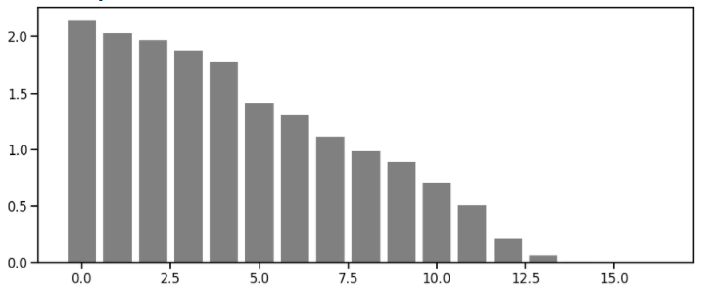
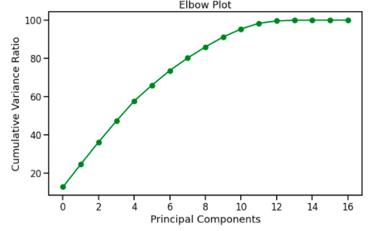
Analysis on : Principal Component Analysis
Now that we’re done, we have to pass our Scaled Dataframe in PCA model and observe the elbow plot to get better idea of explained variance. At 12th component our PCA model seems to go flat without explaining much of a variance.

Slide 29
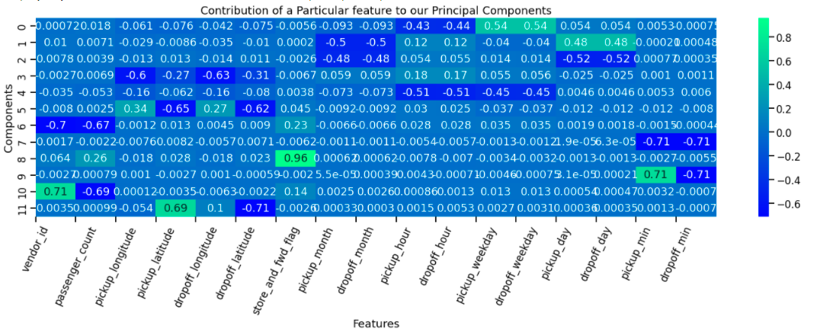
Analysis on: Feature Contribution
Above plot gives us detailed ideology of which feature has contributed more or less to our each Principal Component.
Principal Components are our new features which consists of Information from every other original Feature we have.
We reduce the Dimensions using PCA by retaining as much as Information possible.

Slide 30

Machine
Learning
Model –
Regression

Slide 31
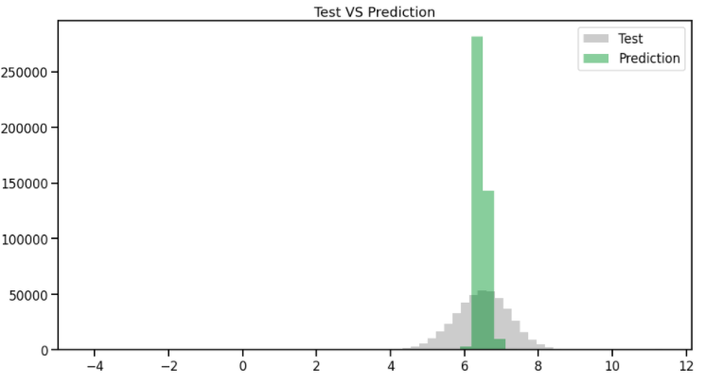
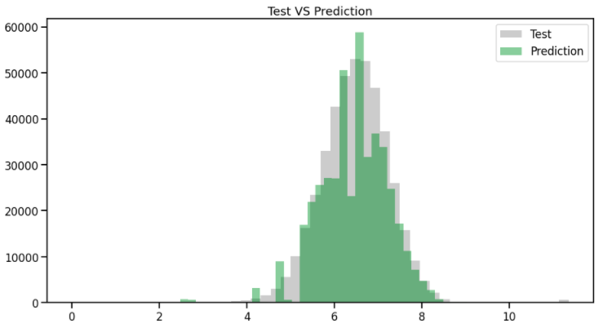
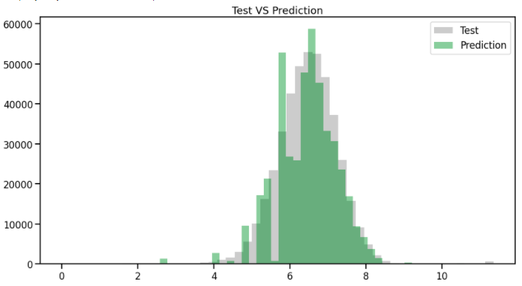
Analysis on: ML Model Prediction with PCA
Linear Regression
Decision Tree
Visualizations show us how our model’s predictions are close to Test Data. It is evident that decision tree and Random forest are performing well.
Random Forest

Slide 32
Analysis on : Model Evaluation Result with PCA
We can clearly observe that our Decision Tree model and Random Forest model are
good performers.
As, Random Forest is providing us reduced RMSE, we can say that it's a model to Opted for.
We're getting good fit score for Decision Tree and Random Forest , i.e., close to 1.0
Algorithms | Training Score | Validation Score | Cross Validation Score | R2-Score | RMSE
Linear Regression | 0.0389 | 0.0509 | 0.0329 | -34.90 | --
Decision Tree | 0.9238 | 0.9149 | 0.9161 | 0.9076 | 0.038
Random Forest | 0.9329 | 0.9260 | 0.9241 | 0.9191 | 0.036
R2-score: Usually must be between 0 and 1, towards 1 considered as good fit.
RMSE: Lesser is Better

Slide 33
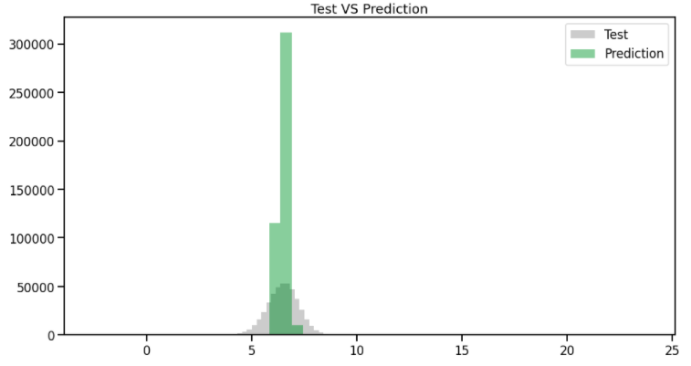
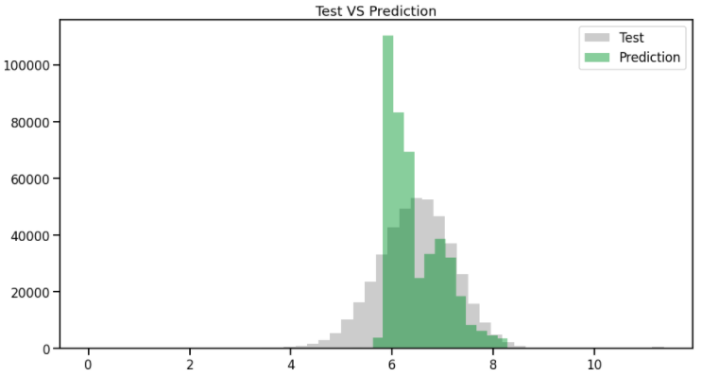
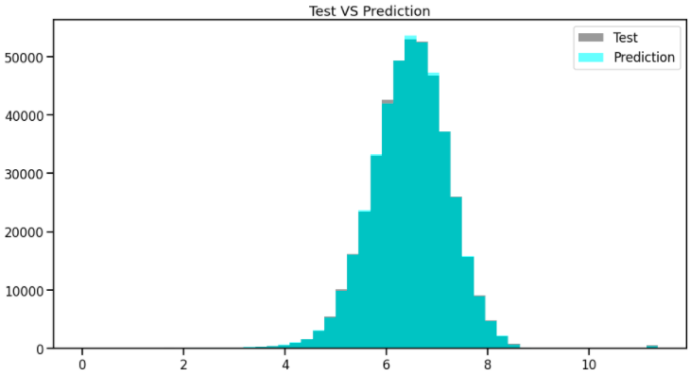
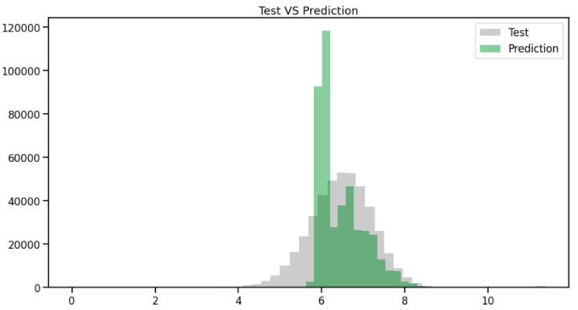
Analysis on : ML Model Prediction without PCA
Linear Regression
Decision Tree
Decision Tree with GridsearchCV
Random Forest

Slide 34
Analysis on : Model Evaluation Result without PCA
We can clearly observe that our Decision Tree with GridsearchCV model are good performers.
As, It is providing us reduced RMSE, we can say that it's a model to Opt for.
We're getting good fit score for Decision Tree with GridsearchCV , i.e, close to 1.0
Algorithms | Training Score | Validation Score | Cross Validation Score | R2-Score | RMSE
Linear Regression | 0.0401 | 0.0517 | 0.0342 | -32.90 | --
Decision Tree | 0.4649 | 0.4555 | 0.4550 | -0.177 | 0.0885
Decision Tree with GridCV search | 0.5135 | 0.4952 | -- | -0.0149 | 0.0857
Random Forest | 0.4803 | 0.4720 | 0.4692 | -0.231 | 0.0874
R2-score: Usually must be between 0 and 1, towards 1 considered as good fit.
RMSE: Lesser is Better

Slide 35
Conclusion
Observed which taxi service provider is most Frequently used by New Yorkers.
Found out few trips which were of duration 528 Hours to 972 Hours, possibly Outliers.
Passenger count Analysis showed us that there were few trips with Zero Passengers and One trip with 7,8 and 9 passengers.
Monthly trip analysis gives us a insight of Month – March and April marking the highest number of Trips while January marking lowest, possibly due to Snowfall.
Taxi giants such as UBER and OLA can use the same data for analyzing the trends that vary throughout the day in the city. This not only helps in better transport analysis but also helps the concerned authorities in planning traffic control and monitoring.

Slide 36
THANK
YOU
Q & A

